Slide 1


From
Introducing….

Slide 2
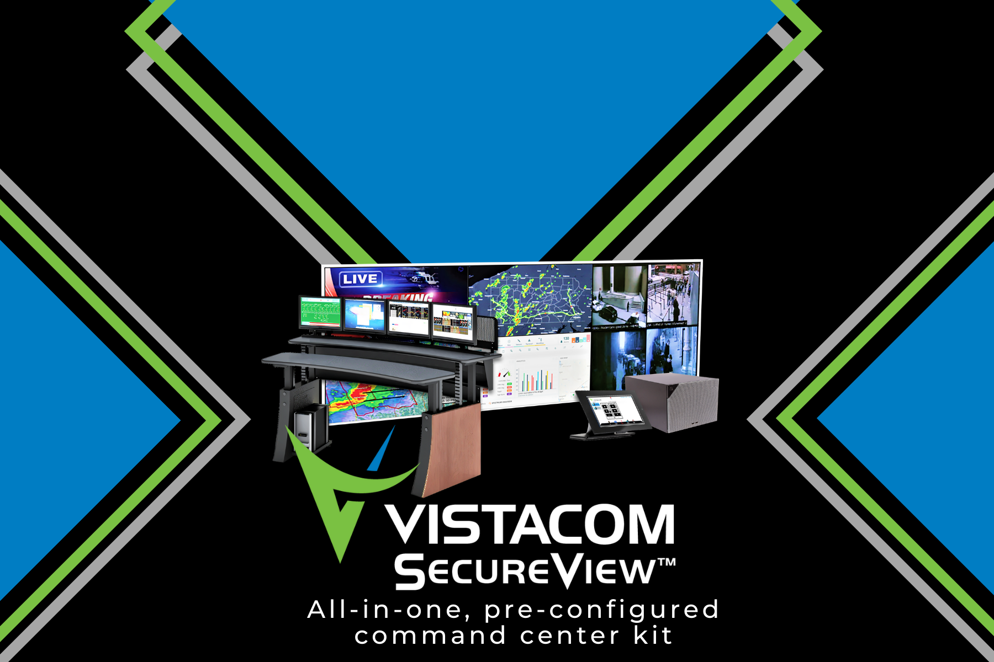

Slide 3
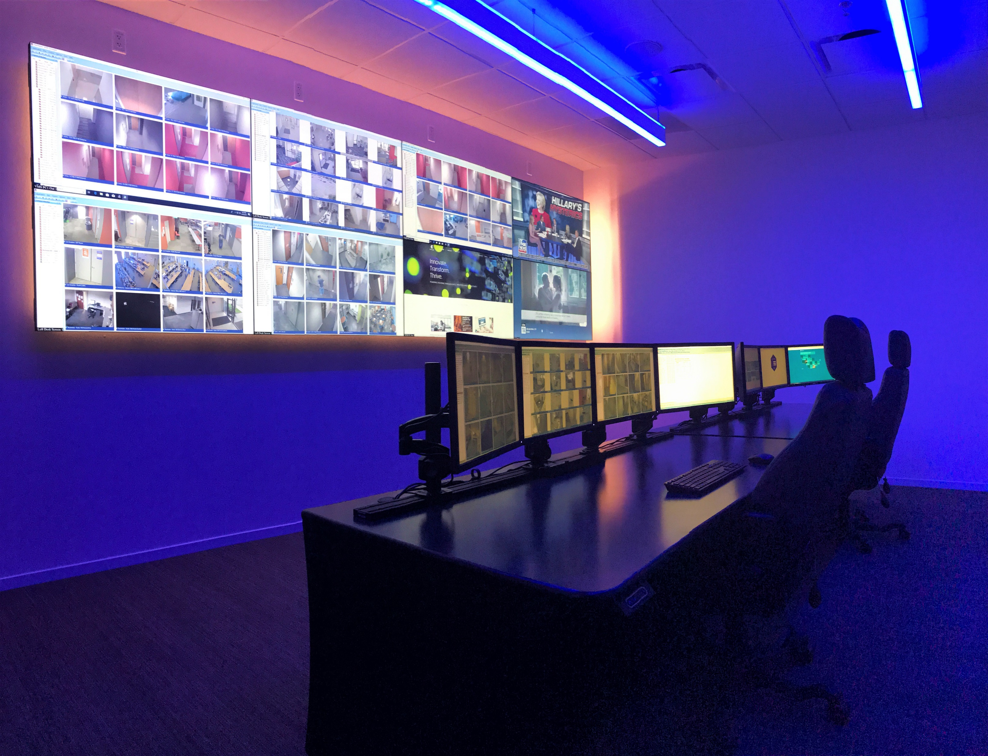



Slide 4
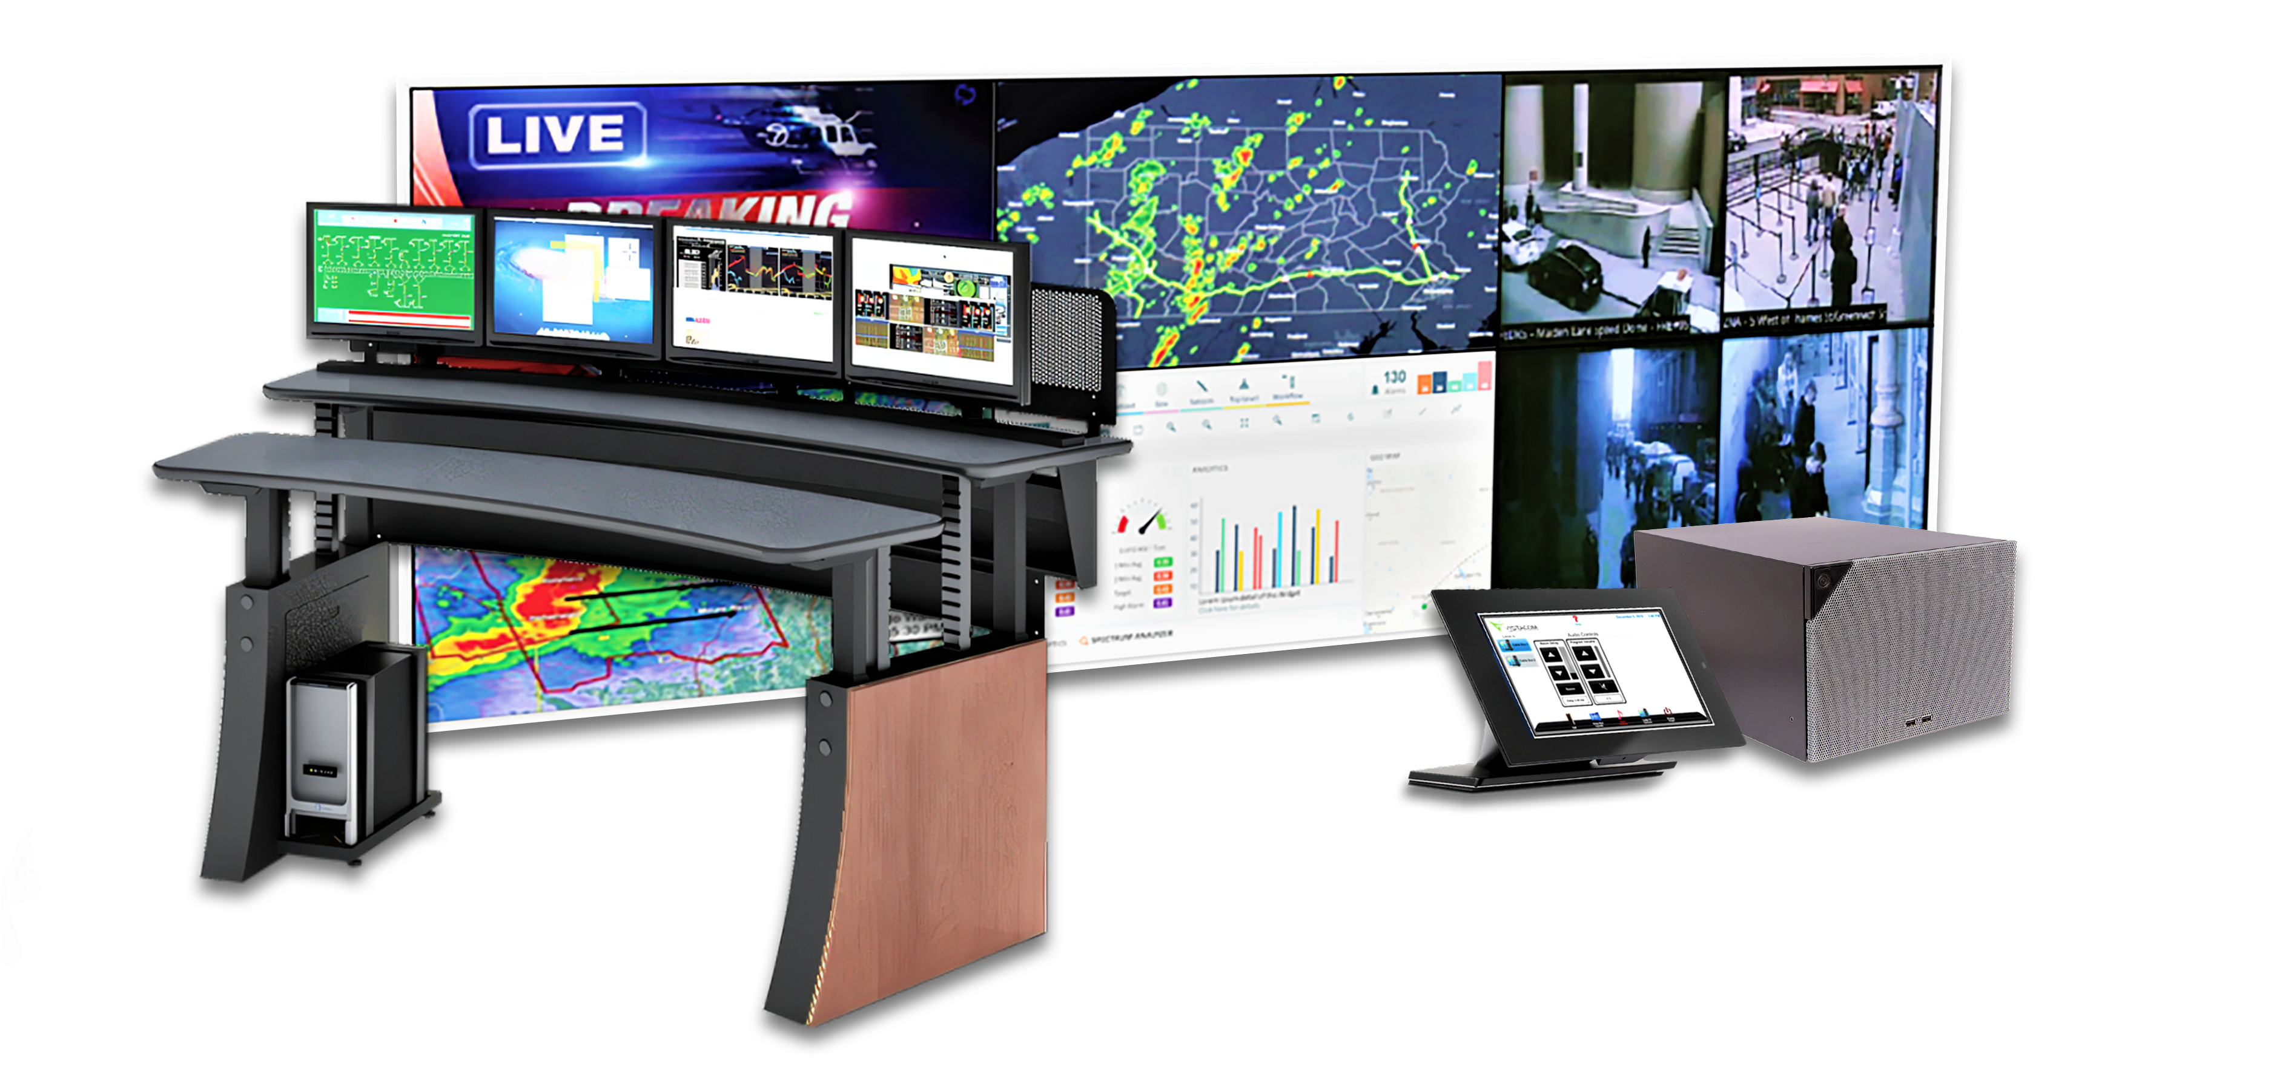
Enabling Command Center Self-Assembly
A highly affordable
Reliable
Pre-engineered
visualization solution.

Slide 5
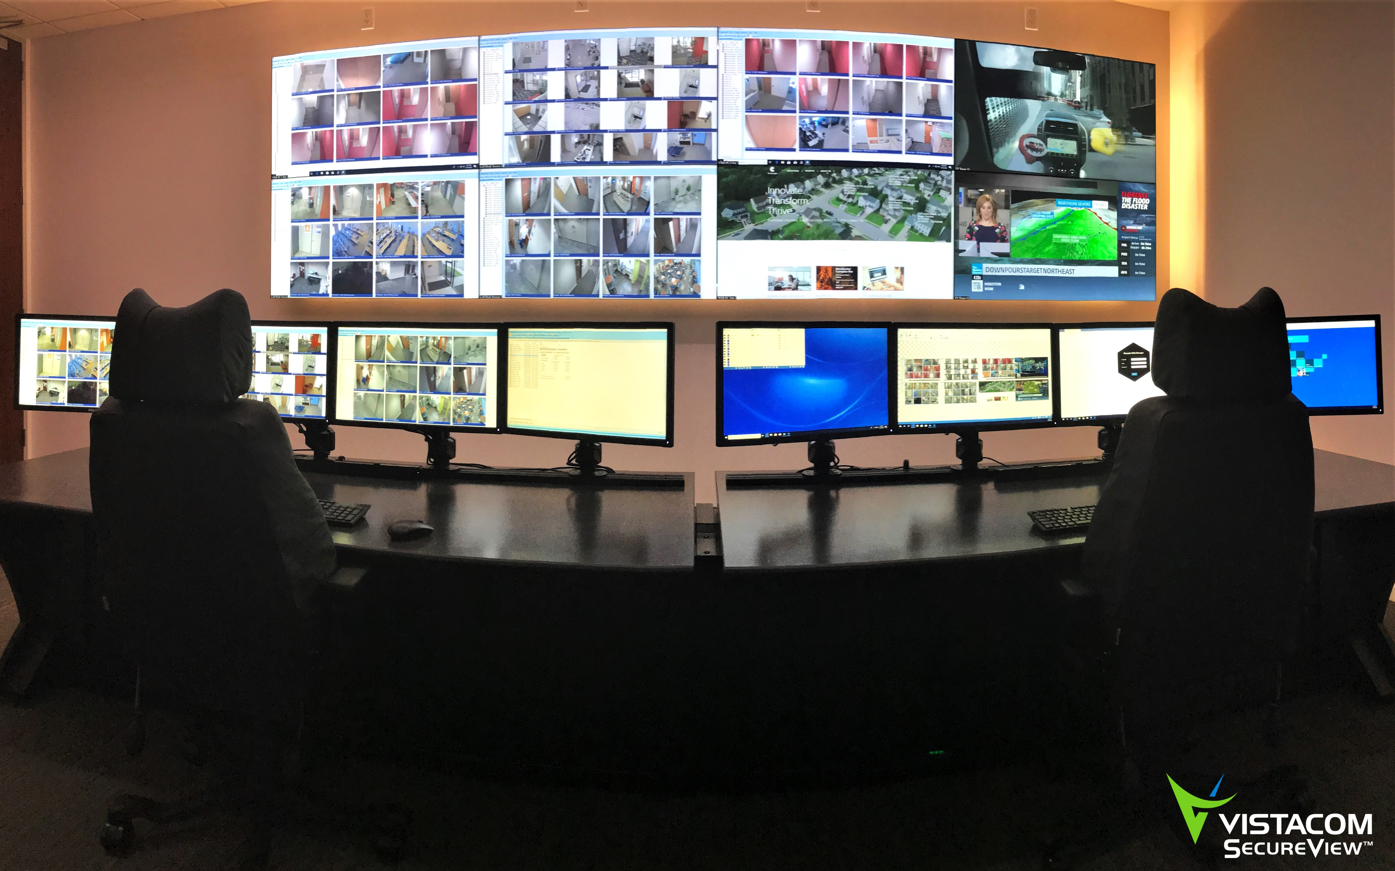

Slide 6








It makes easy self-assembly a reality for
small and medium operations centers with:
Hand-selected, best-in-class, pre-configured products
Expert remote support
A number of factory-tested configurations to choose from

Slide 7
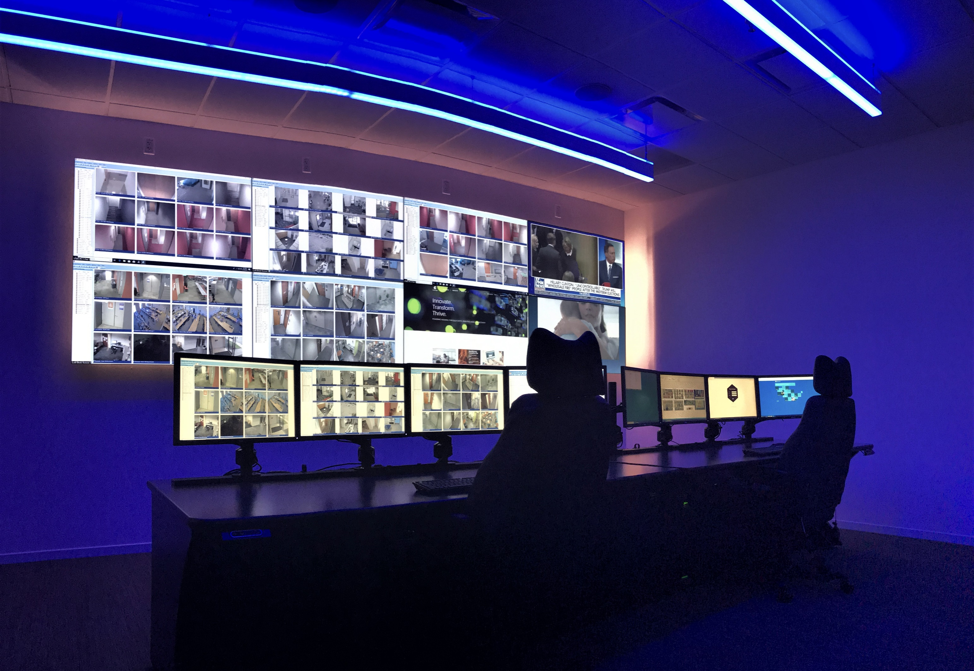

Slide 8


Slide 9

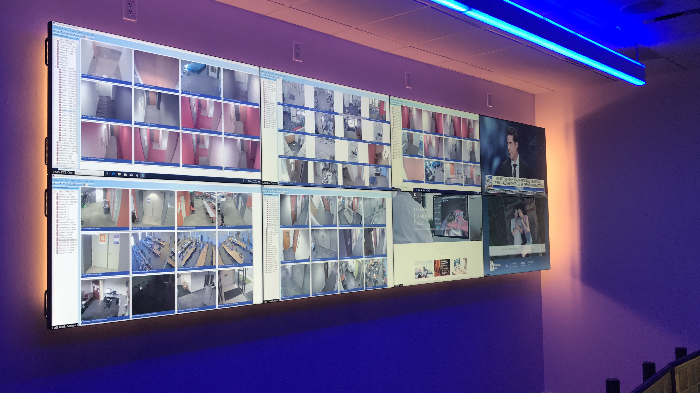
The Most Straightforward & Intuitive of Its Kind
provides operators with a
single-pane-of-glass view of operations across their infrastructure and enables the seamless assimilation of data feeds while creating a more simplified workflow.

Slide 10

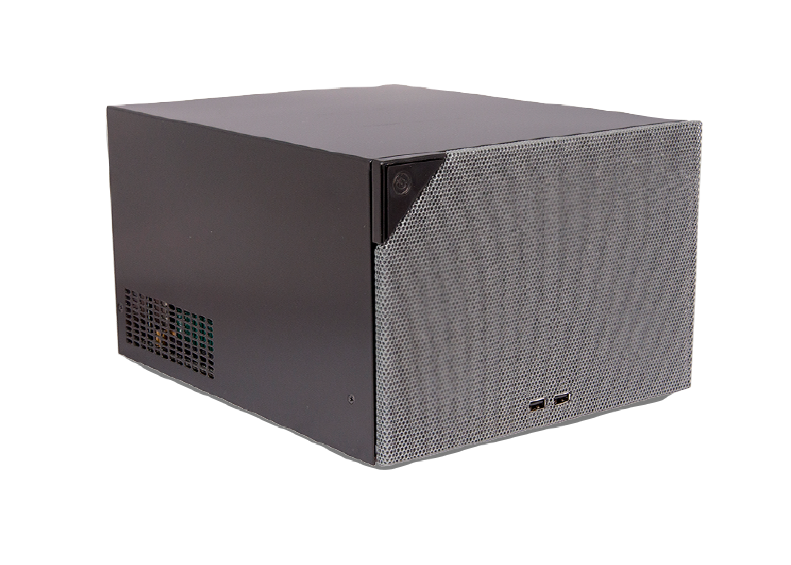




Unbox the Possibilities
Featuring a powerful, compact video processor providing flexibility and superior performance
High-quality 24/7-rated
displays in pre-selected
sizes and configurations

Slide 11
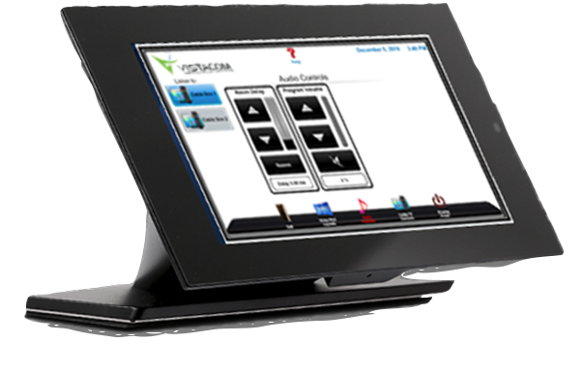

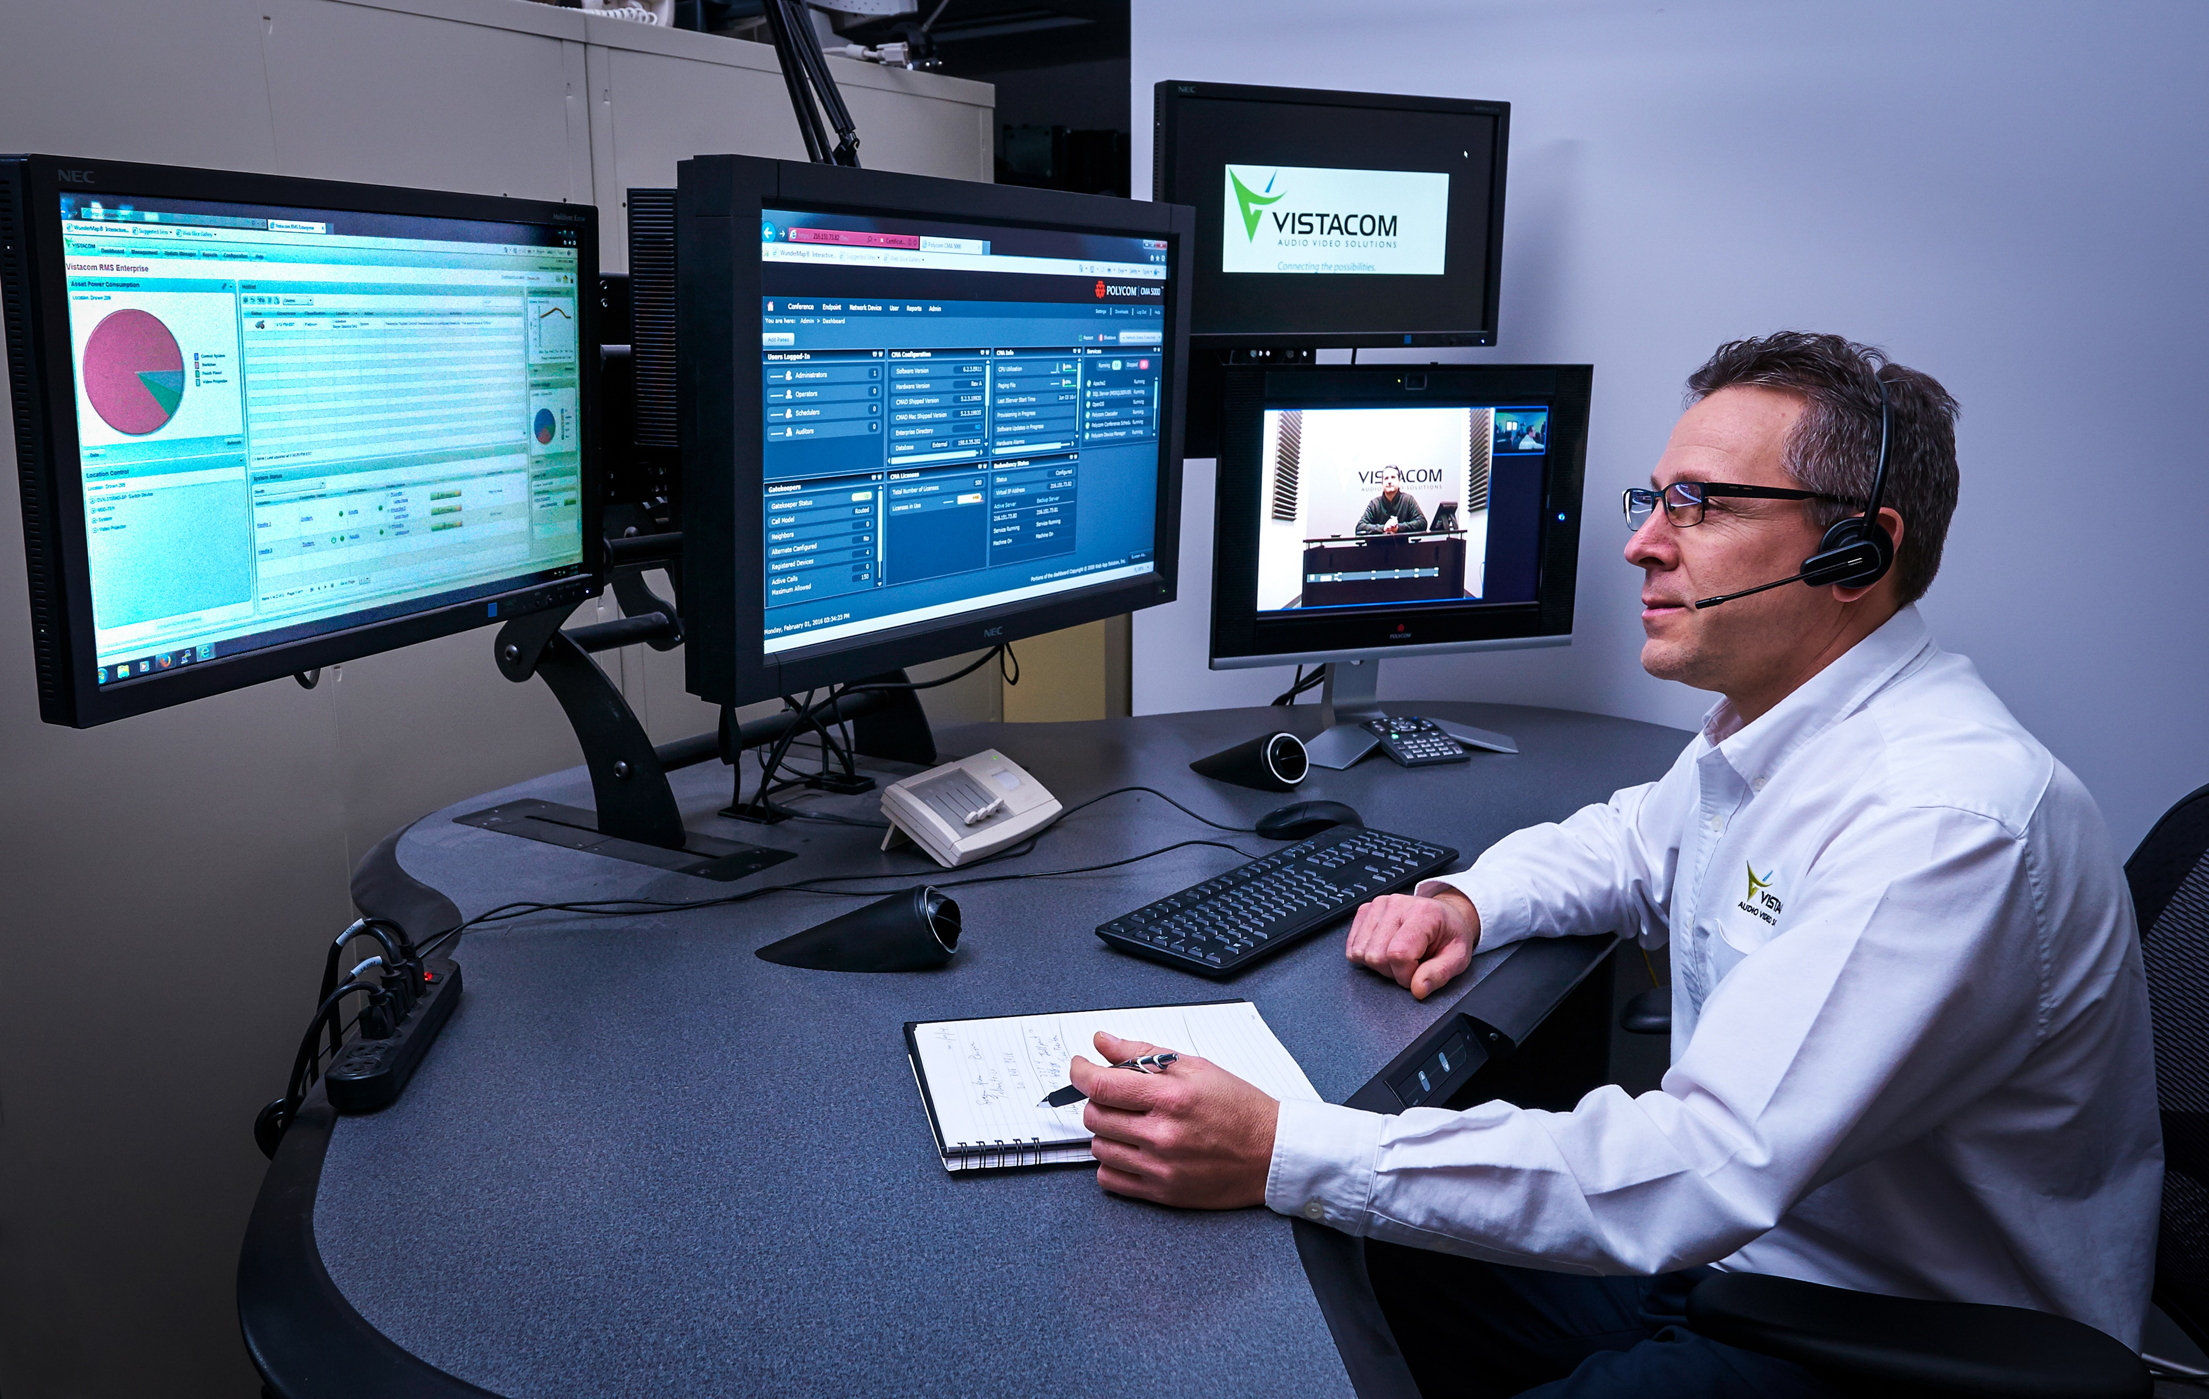
Unbox the Possibilities
(Continued)
A 10” tabletop touch panel with user-friendly interface
Two-year warranty with expert remote support

Slide 12

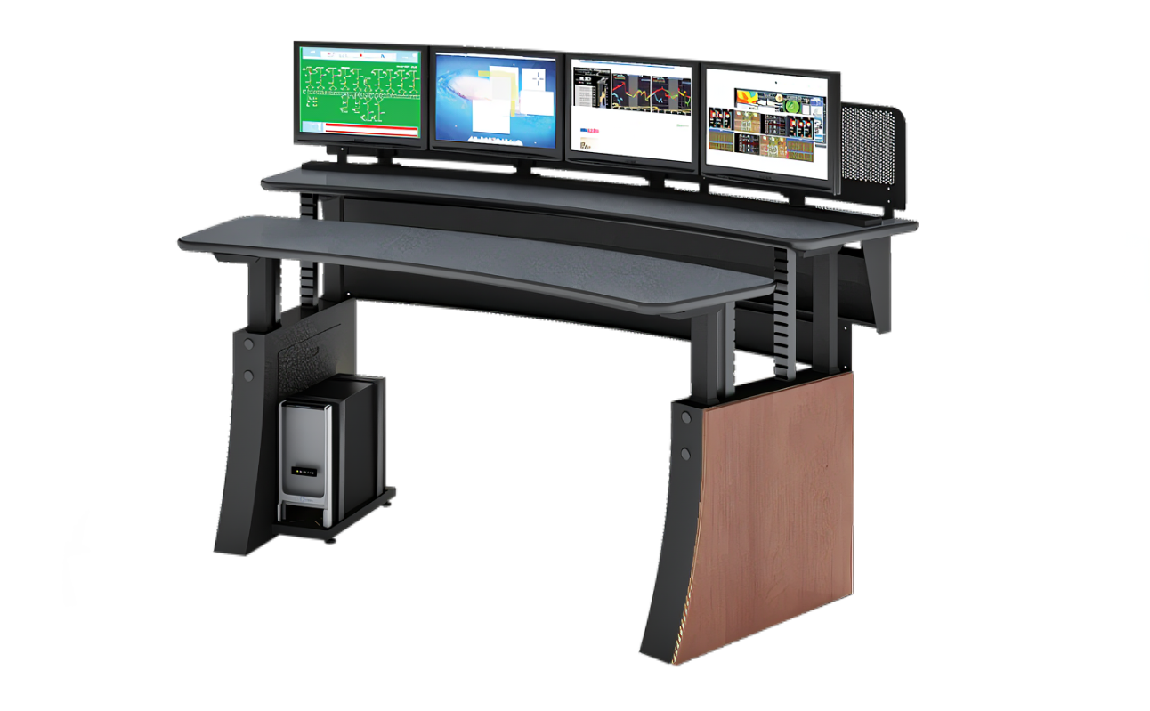
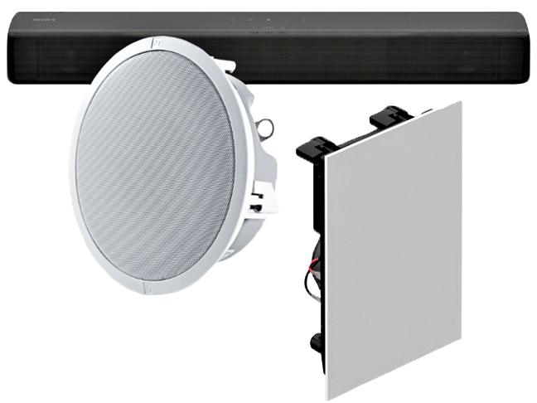
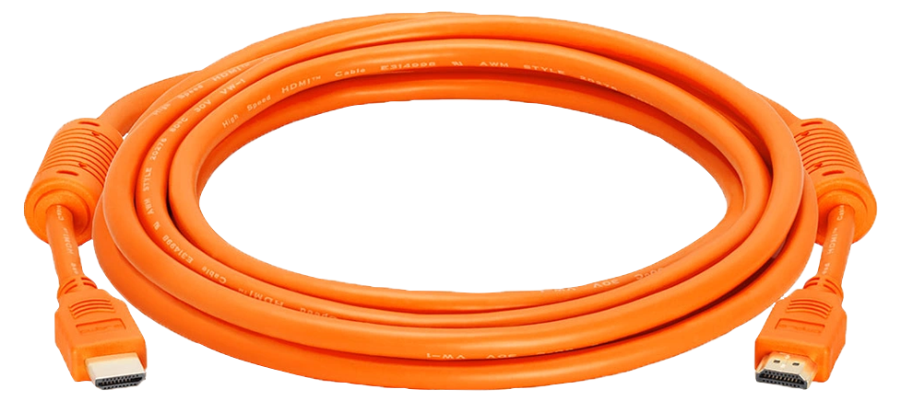
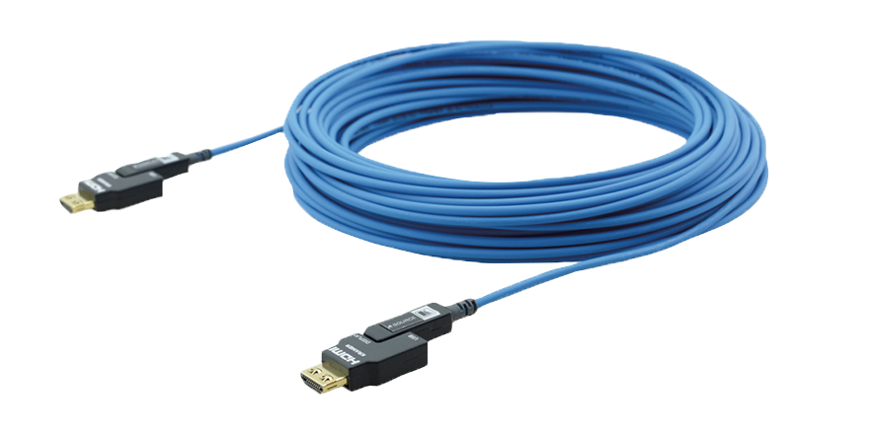
Including Workflow-Specific Convenience Options
Choice of 0 – 4 operator consoles
Wall or floor
mounting
Standard or
extended cabling
Audio options specific
to your environment

Slide 13
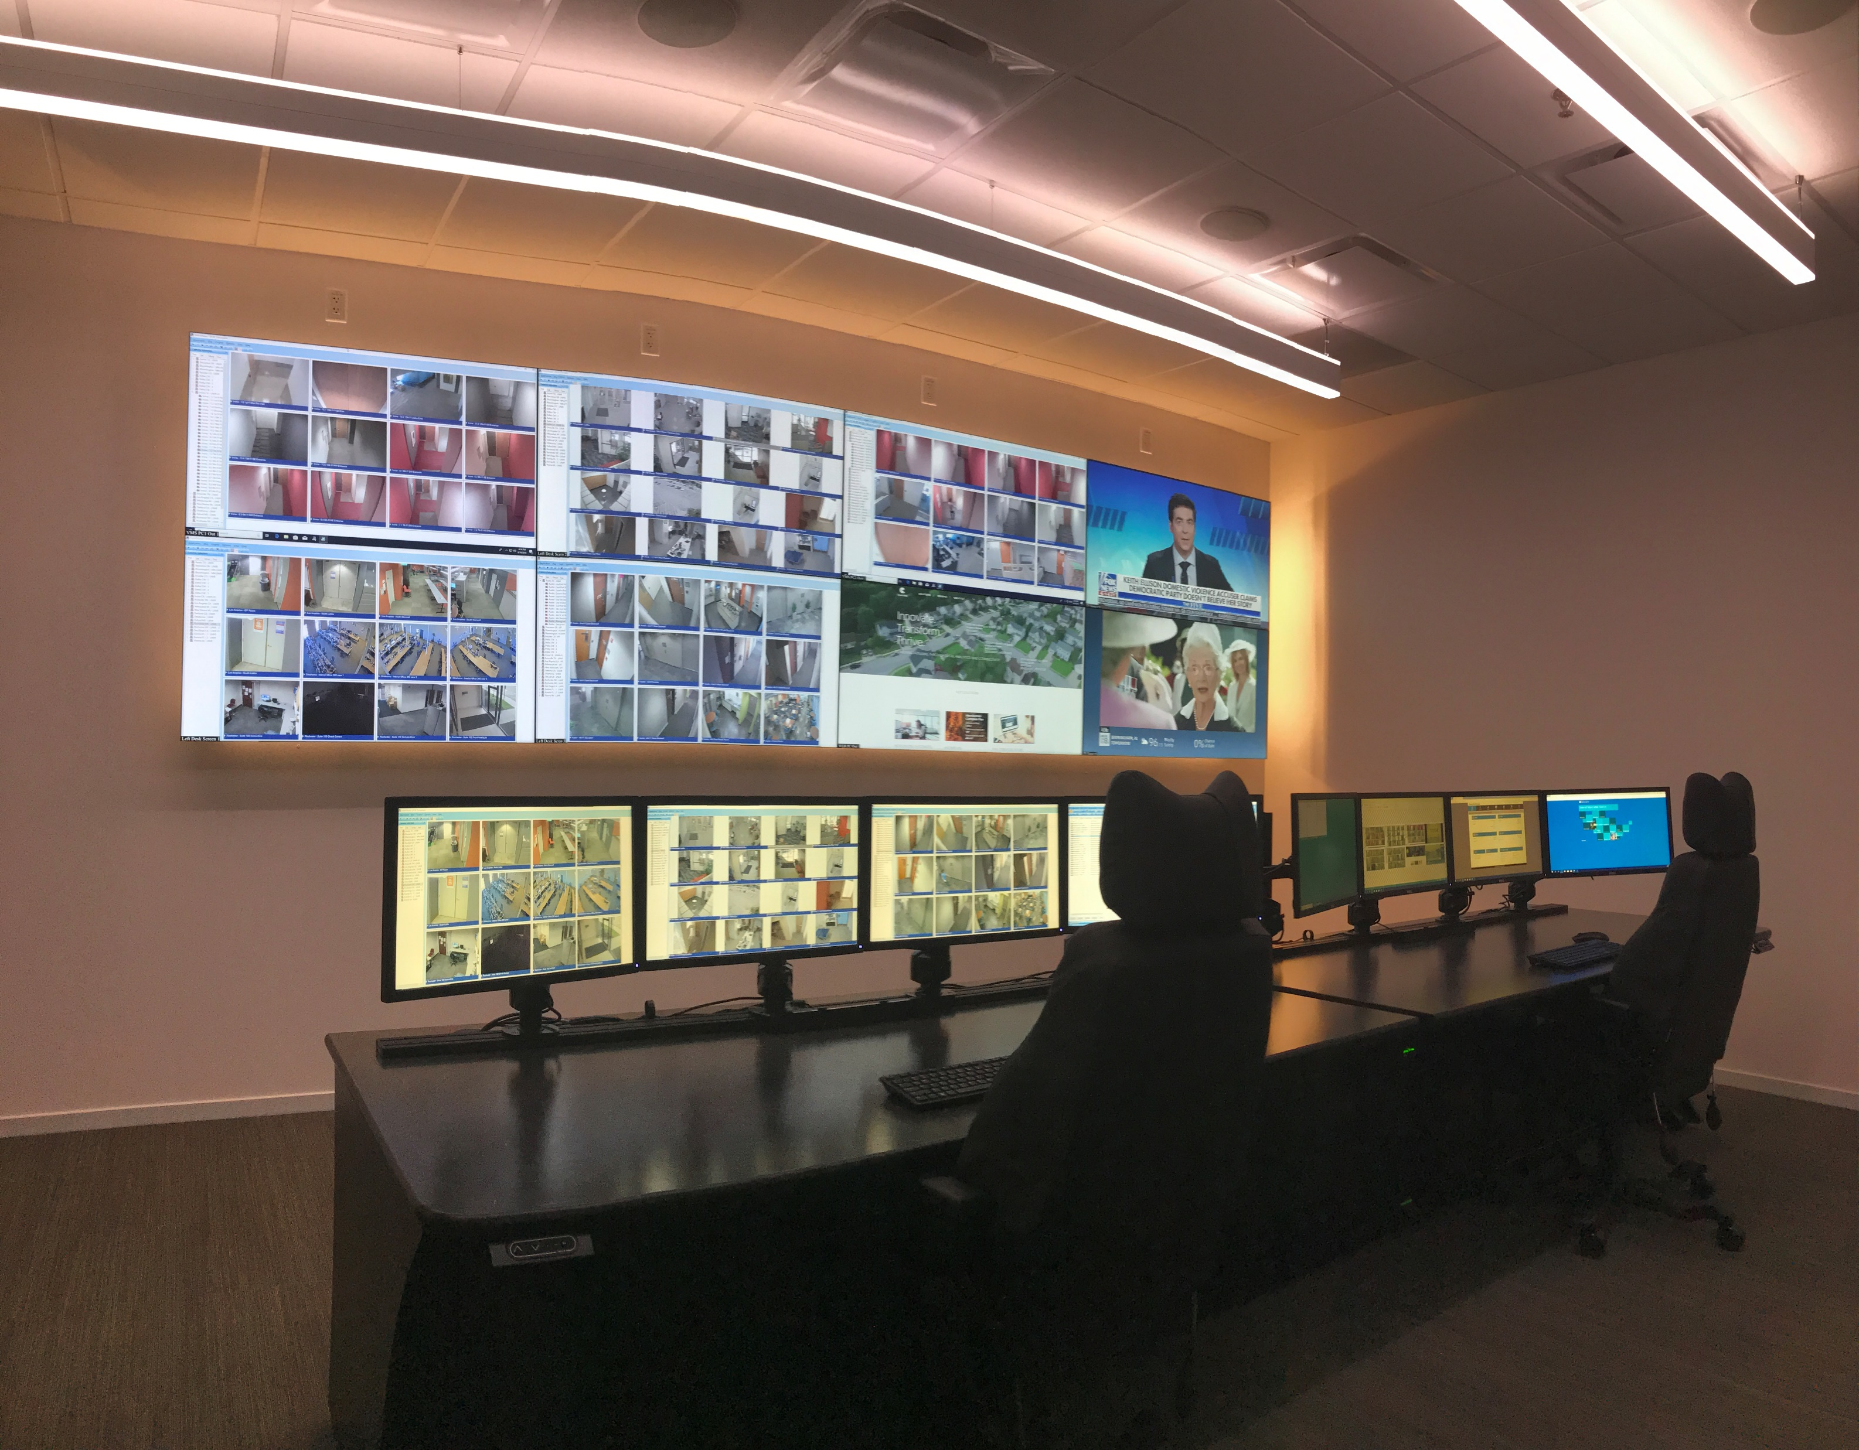

Slide 14
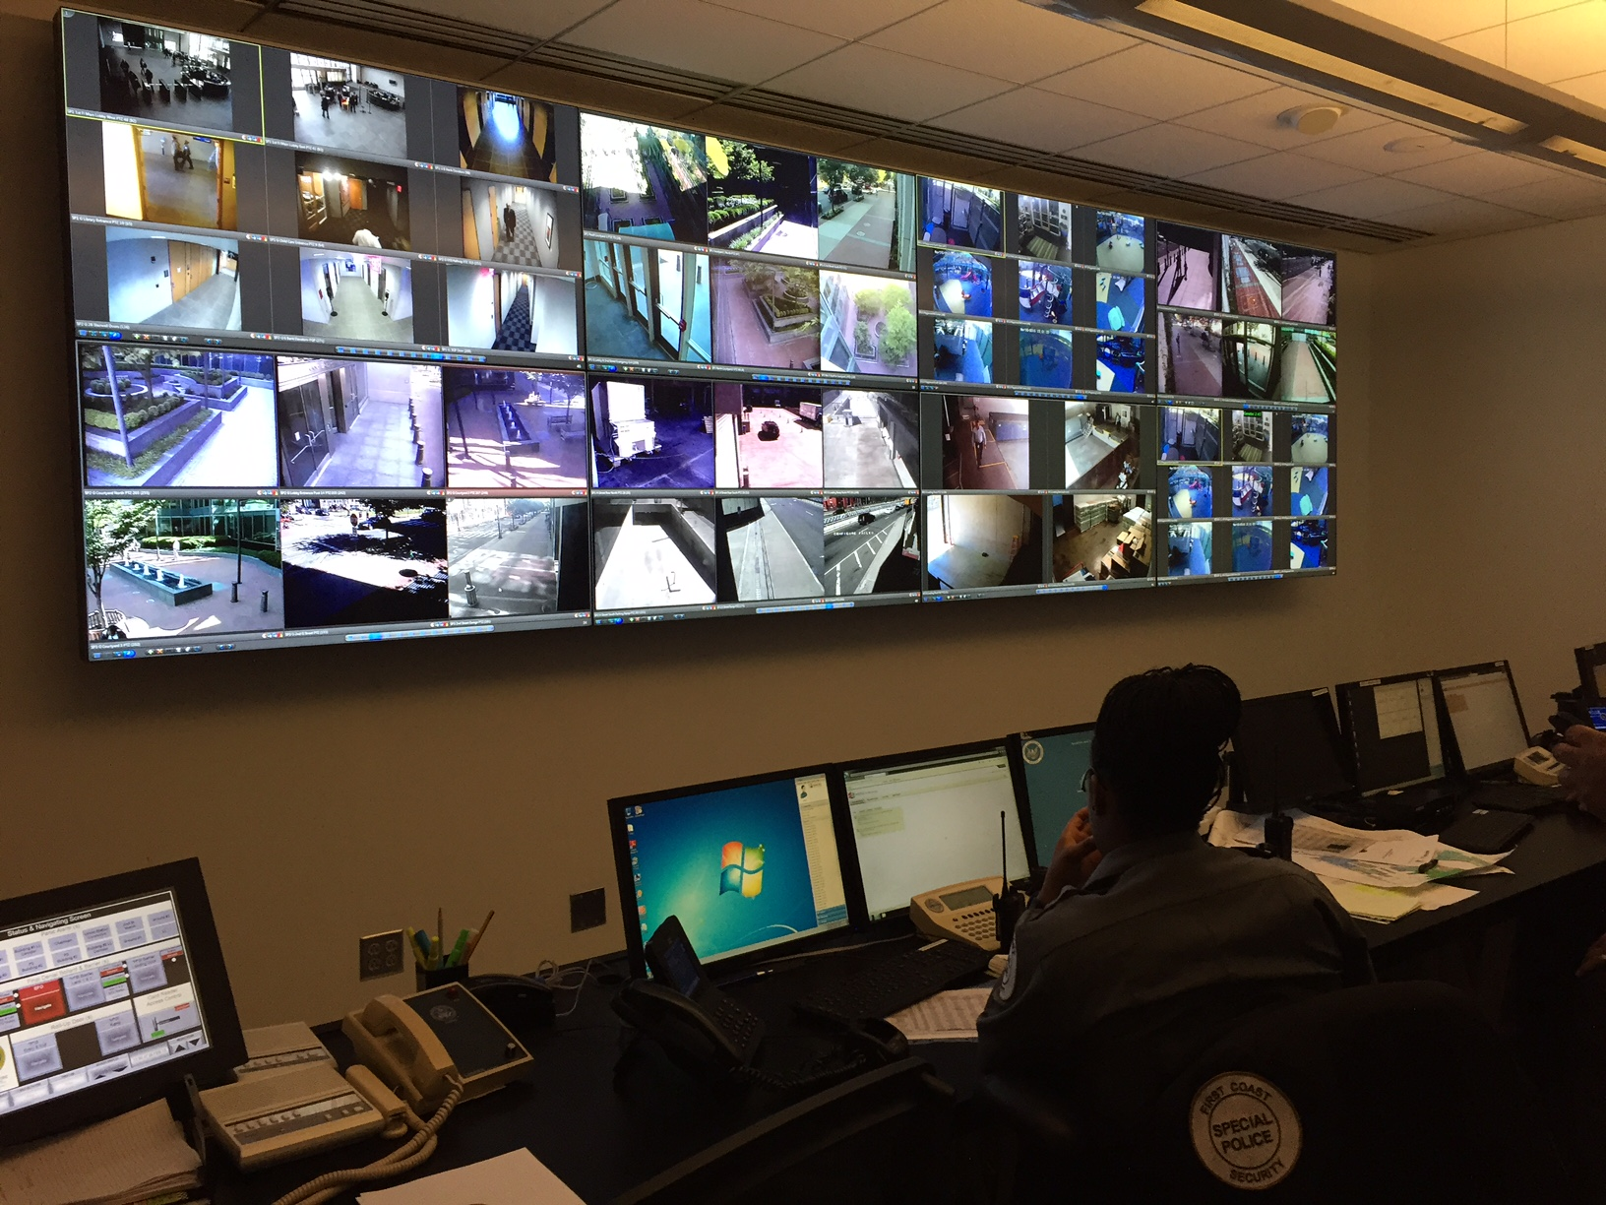

Slide 15

2022 Winner of the Innovation Award in Command & Control
at the Electronic Security Exchange

Slide 16
Vistacom SecureView™
helps operators gather data for enhanced situational awareness, and engage in intelligent, proactive response.

Slide 17
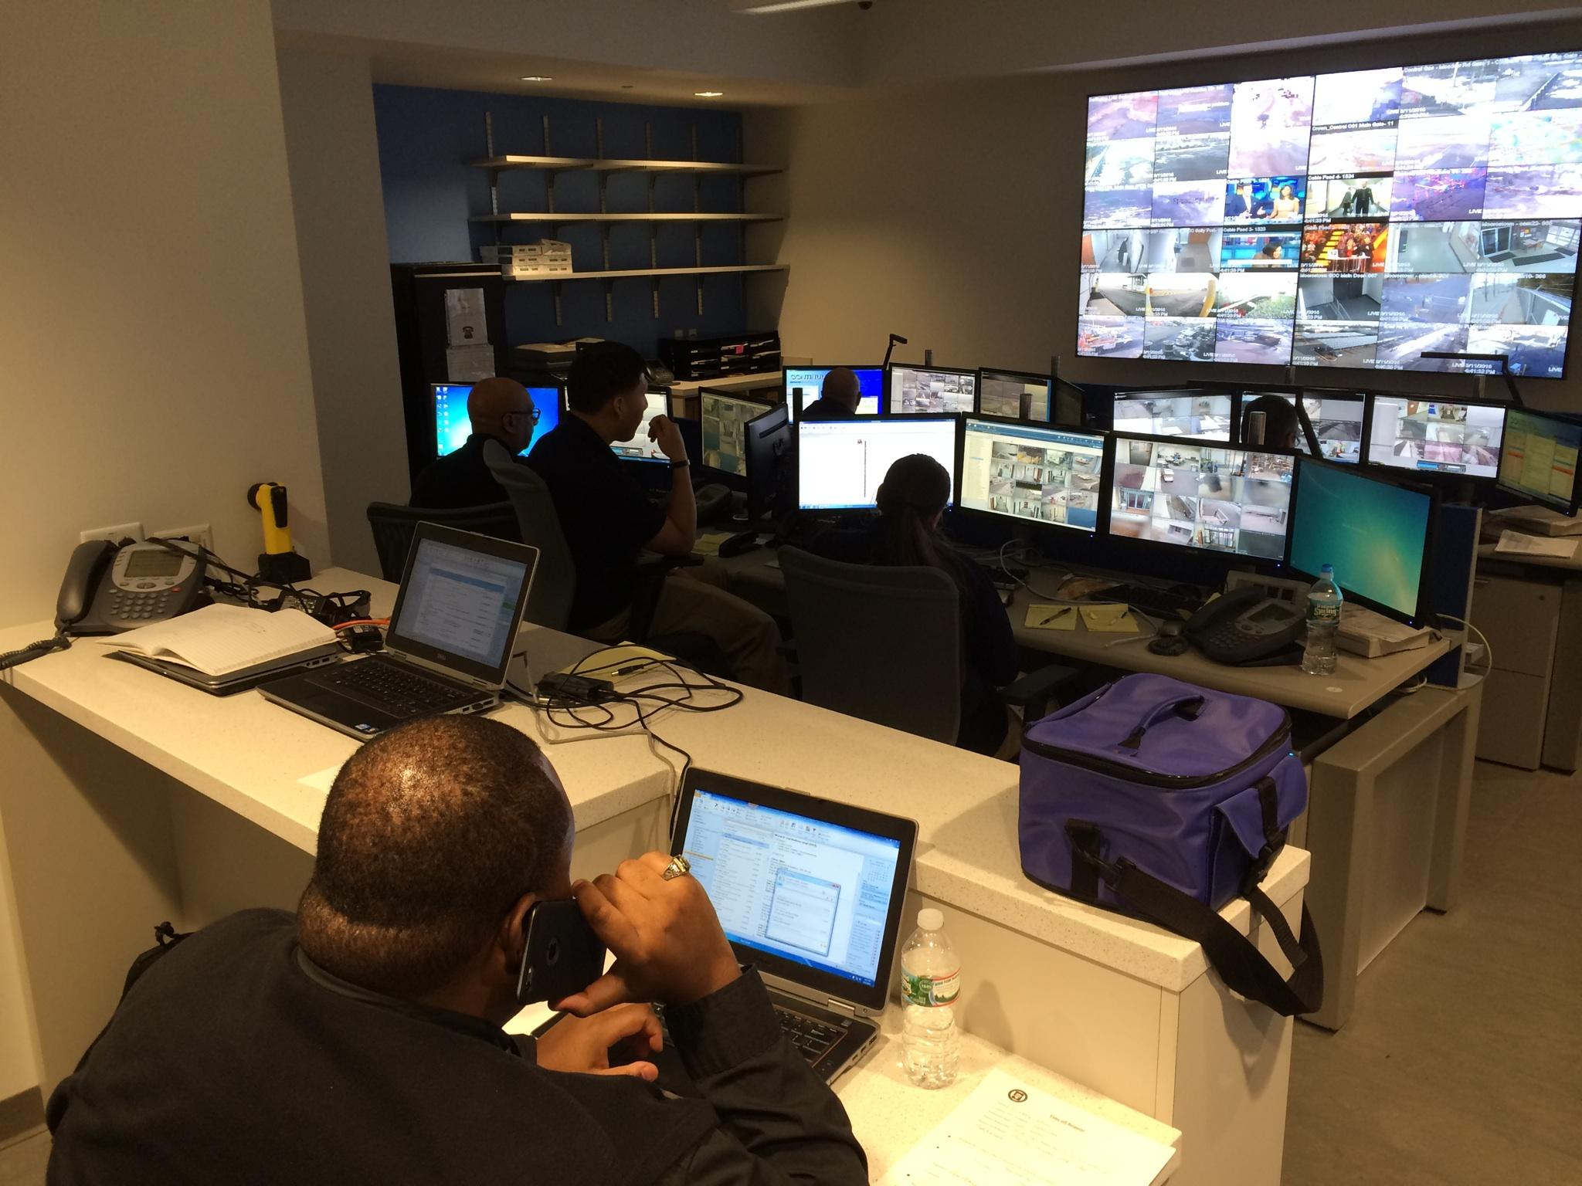

Slide 18
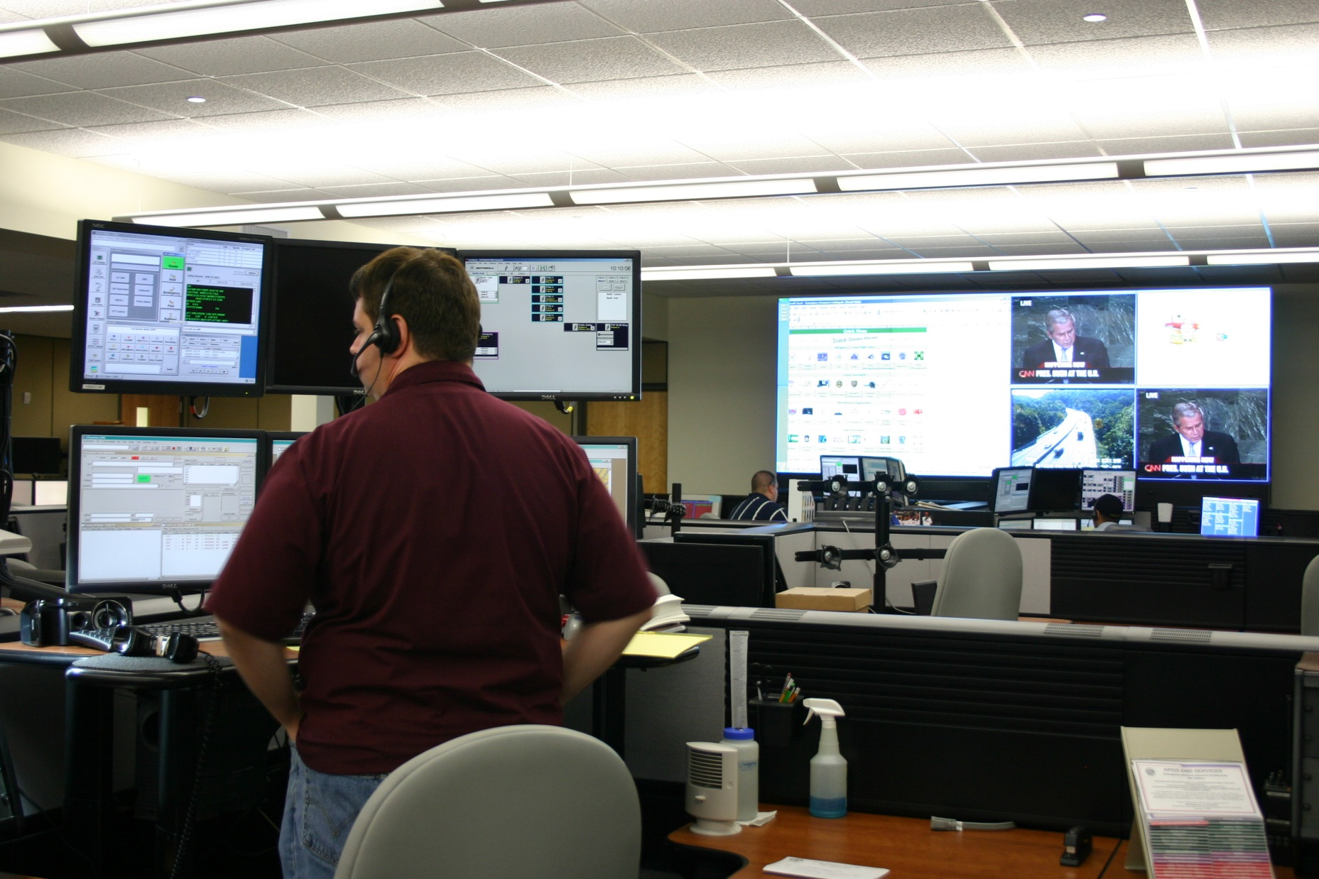

Slide 19
Vistacom’s command center solutions provide the
RIGHT information to the
RIGHT people at the
RIGHT time.

