Slide 1


Bosch IP Video Systems Technology Value Proposition
www.MidChes.com
Security Systems
ST-VS/MKT | 10/21/2013 | © 2013 Robert Bosch LLC and affiliates. All rights reserved.

Slide 2

Our key technologies
Bosch IP Video Systems Technology Value Proposition
1
Content Based Imaging Technology (CBIT)
2
Intelligent Video Analysis (IVA)
3
Dynamic Transcoding
4
Efficient and robust recording solutions – Video Recording Manager
Security Systems
ST-VS/MKT | 10/21/2013 | © 2013 Robert Bosch LLC and affiliates. All rights reserved.

Slide 3
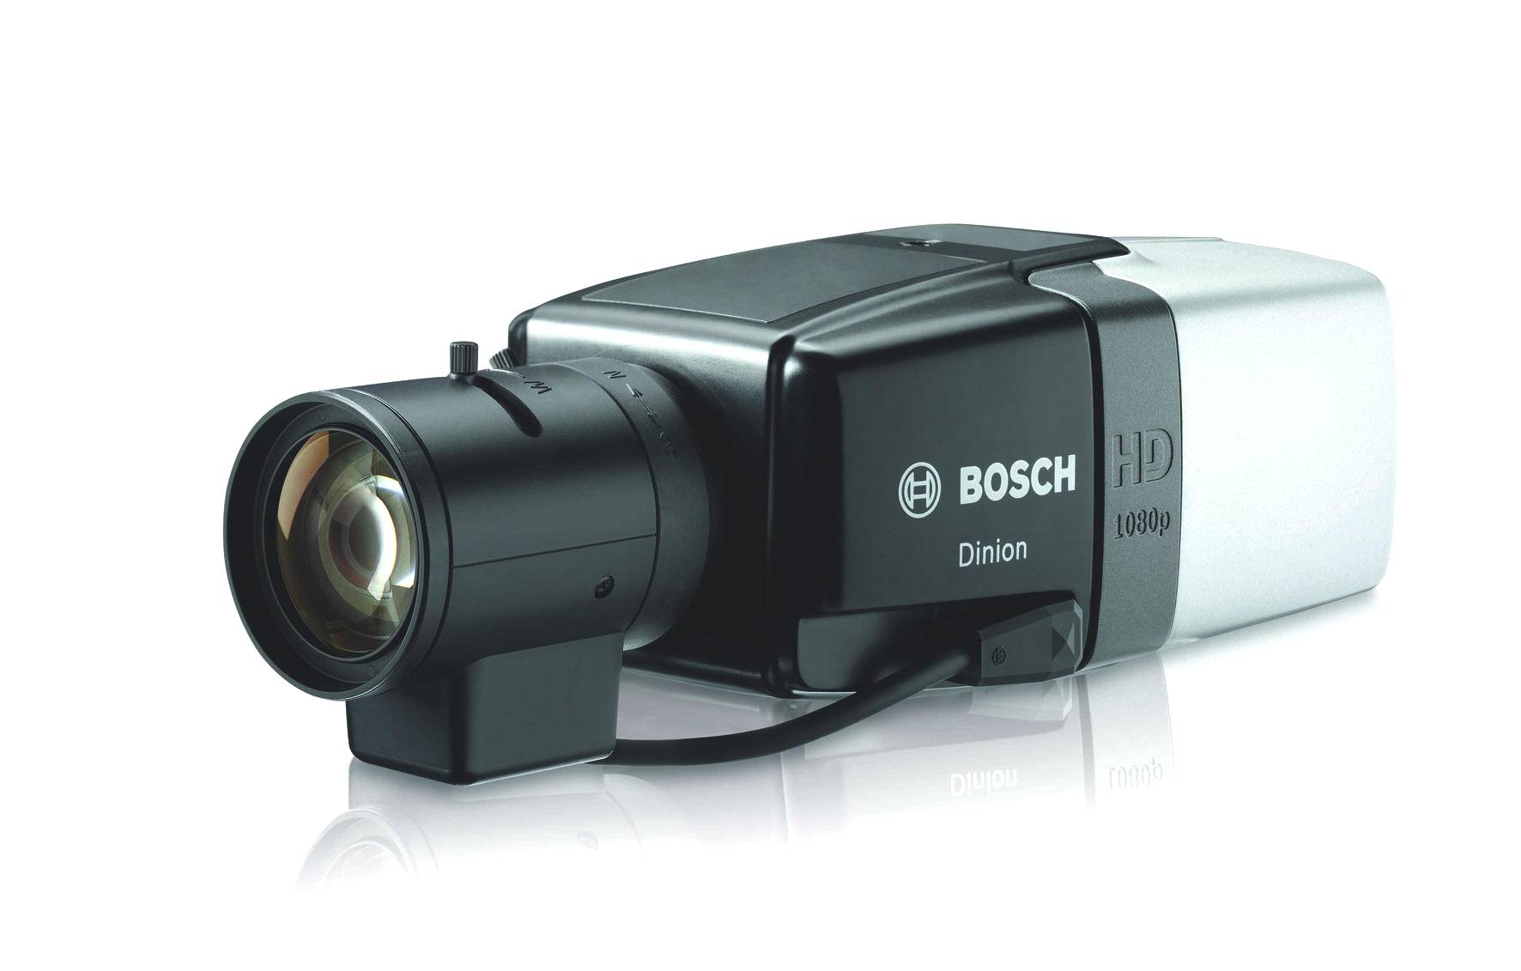
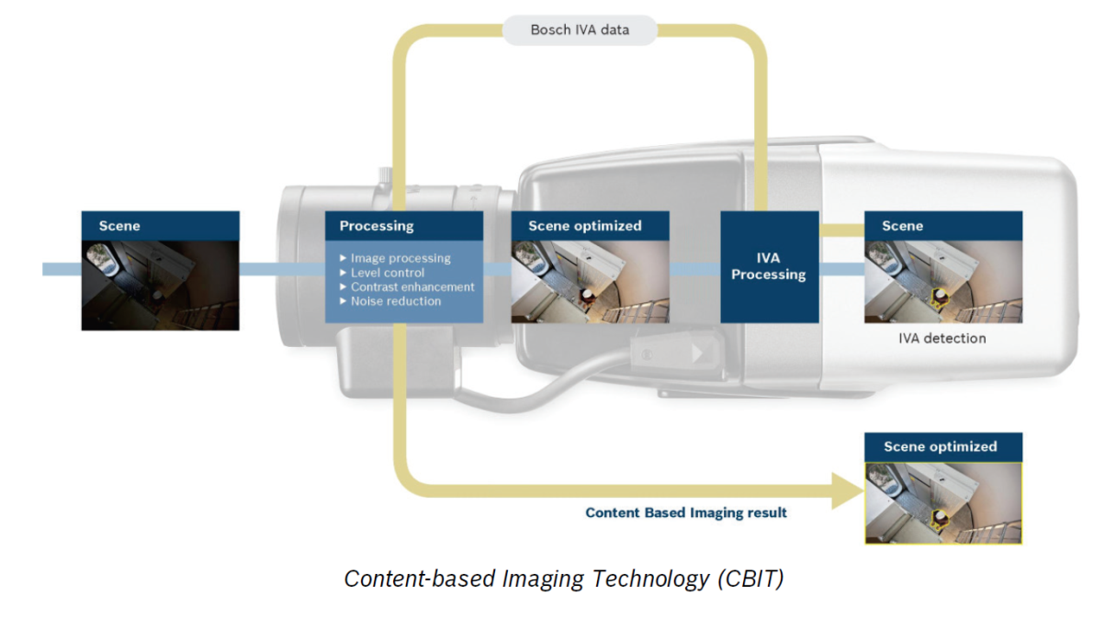
  Content Based Imaging Technology (CBIT)
Bosch IP Video Systems Technology Value Proposition
1
Video images are tailored to the content of the scene resulting in best usable video surveillance images in every situation most cost effectively
Improving identification
Improving awareness
Reducing system costs
intelligent Dynamic Noise Reduction (iDNR)
intelligent Auto Exposure (iAE)
intelligent Tracking (iTracking)
Security Systems
ST-VS/MKT | 10/21/2013 | © 2013 Robert Bosch LLC and affiliates. All rights reserved.
Notes:
iDNR:
Noise reduction based on scene content
Reduces storage requirements up to 50% in static scenes
No compromise on image quality – crisp images even at night
iAE
Is the most impressive intelligent backlight compensation in the market. This feature is using IVA to dynamically adjust the camera to allow moving objects are always visible.
Dynamic range is extended based on scene content
Clear visibility of moving objects in dark and bright areas
Best usable images in changing lighting conditions
No over-exposure of objects
iTracking
Automatically track moving objects
Track people or object by a simple click
Field of view continuously adapted to the movement of the tracked object
System costs include:
Reduction of storage costs
Also includes the savings that can be made on less storage space requirements

Slide 4
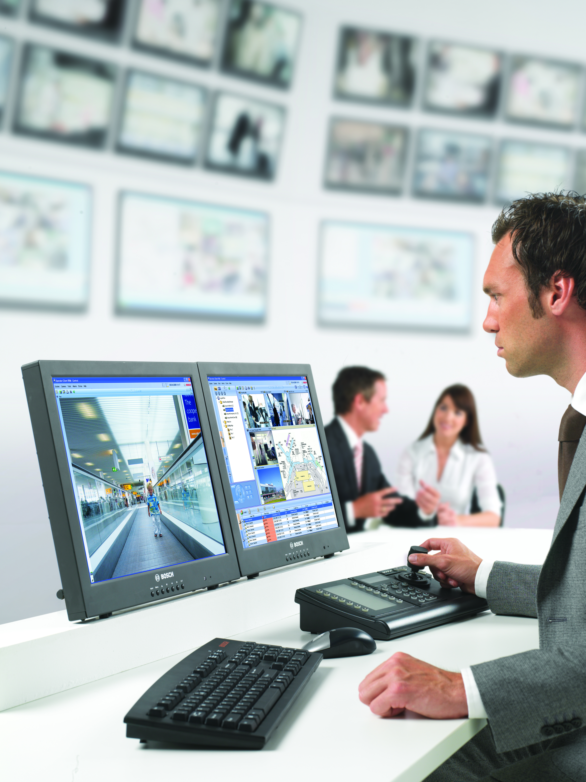
Intelligent Video Analysis
An introduction…
Bosch IP Video Systems Technology Value Proposition
2
Bosch adds sense and structure to video surveillance images
Bosch camera with build-in IVA understands what it sees
  can trigger alarms
  can automatically optimize image processing
  can retrieve evidence very fast (forensic search)
Bosch IVA camera becomes an active member of your team to
support the further enhancement of safety and security.
Security Systems
ST-VS/MKT | 10/21/2013 | © 2013 Robert Bosch LLC and affiliates. All rights reserved.
Notes:
All cameras capture video surveillance images. Bosch however adds sense and structure to video surveillance images by offering Intelligent Video Analysis (IVA) on the edge.
IVA analyzes each image and adds sense (metadata) to it. The camera with build-in IVA understands what it sees and can trigger alarms based on IVA rules stored in the camera as well as automatically optimizes the image processing to capture the best usable image. Evidence can be retrieved very fast by forensic search. Even detection rules can be changed afterwards.
The intelligent camera becomes an active member of your team to support the further enhancement of safety and security.

Slide 5
Intelligent Video Analysis (IVA)
Bosch IP Video Systems Technology Value Proposition
2
Benefits
Always alert, never asleep
Fast and reliable
Improves return on investment
Reduces system costs
Offers future proof solution
Security Systems
ST-VS/MKT | 10/21/2013 | © 2013 Robert Bosch LLC and affiliates. All rights reserved.
Notes:
Always alert, never asleep (Enhances safety and security)
- Focus attention on things that matter
Detect possible suspicious events instantly
Never asleep; 24/7 extra pair of eyes to support you
Maximum reliability and robustness, distributed intelligence (in each camera) is reliable intelligence
Fast and reliable ( increases effectiveness)
Fast retrieval of evidence (forensic search)
Searching recorded material using new detection criteria
Learning; analyze metadata to re-adjust IVA settings
Improves return on investment
POS analysis to optimize shop layout
Get customer statistics: people counting, conversion rates
Reduces system costs
No video streaming required for analysis
No central equipment required for analysis. It works beyond network quality and availability
Scale the system without additional servers, racks etc.
No central equipment, saves maintenance costs
Offers future proof solutions:
Easy scalable, Simply add an IVA camera or encoder

Slide 6
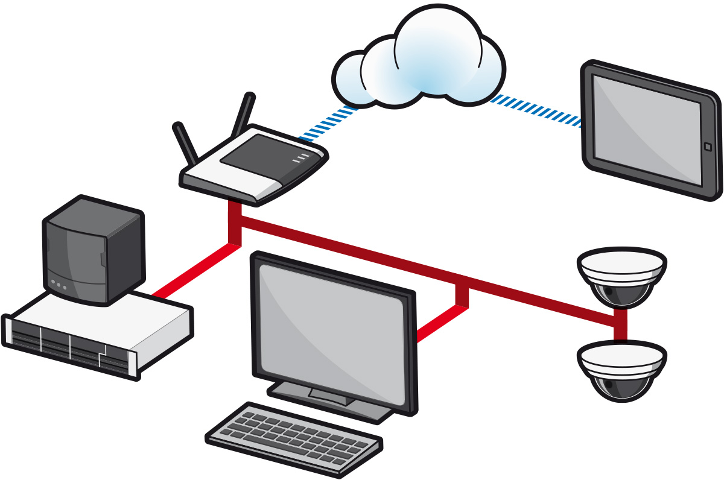


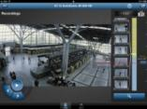
Dynamic Transcoding
Bosch IP Video Systems Technology Value Proposition
3
Offering full access and control 24/7 regardless available bandwidth
Anywhere, Everywhere
Smooth video
HD details; no aggressive compression needed
All information; no compromise on fps
Limited bandwidth
connection
bandwidth
managed
Remote access to
HD material 24/7 &
control
Standard internet router
Full HD cameras
Storage & transcoding
Viewing station
Security Systems
ST-VS/MKT | 10/21/2013 | © 2013 Robert Bosch LLC and affiliates. All rights reserved.
Notes:
Smooth video
- Stream tailored available bandwidth
Easily look for suspicious events (movement)
HD Quality
Suspicious event identified? Press pause and HD detail will appear
No compromise due to aggressive compression
All information
Regardless bandwidth there are no compromises made on frames per second (fps)
All information is kept

Slide 7
Video Recording Manager (VRM)
Bosch IP Video Systems Technology Value Proposition
4
Maximum reliability and most cost effective performance
Reduced system costs
Low energy consumption
No storage servers needed
Maximum reliability
Peace of mind
Less configuration due to lesser amount of components
No daily anti-virus updates (servers)
Easy set-up and maintenance
Reduced number of components
No servers
Expansion of system only iSCSI storage to be added
No single point of failure - Automatic re-routing
Minimizing risk of overwriting
Less storage usage: balancing video streams automatically
No weekly patches for operating system (OS)
Security Systems
ST-VS/MKT | 10/21/2013 | © 2013 Robert Bosch LLC and affiliates. All rights reserved.
Notes:
Reduces System costs:
Direct-to-iSCSI recording: IP camera responsible for recording:
No NVR’s or extra NVR’s needed when expanding the system. Only additional iSCSI storage needed
No redundant storage
Maximum reliability
- Automatic re-routing of recording in case iSCSI device fails / not accessible (failover)
- Less HW & SW components needed
- No redundant storage
- Minimizing risk of overwriting before required retention time
Higher efficiency
- Storage usage: balancing video streams automatically
- Lower energy consumption: reduced no. of components
Peace of mind
Easy set-up and maintenance
Less configuration due to lesser amount of components
No daily anti-virus updates (NVRs)
No weekly patches for the operating system (OS)

Slide 8


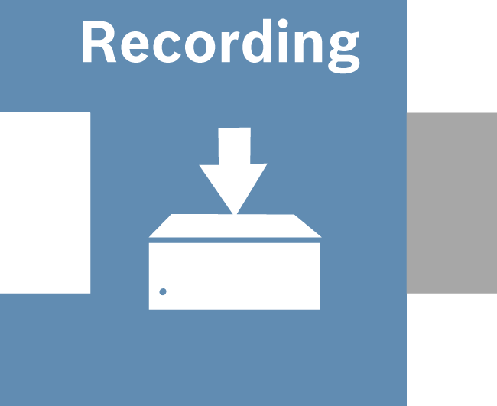


Total solution or 3rd party integration without barriers
Bosch IP Video Systems Technology Value Proposition
Security Systems
ST-VS/MKT | 10/21/2013 | © 2013 Robert Bosch LLC and affiliates. All rights reserved.

Slide 9

Our benefits
Bosch IP Video Systems Technology Value Proposition
Substantially reducing your system costs without compromising on image usability, system reliability and robustness
Enhancing safety & security
Offering maximum flexibility / freedom
Optimizing business processes by increasing effectiveness and reducing cost of operation
Benefits
We have everything to gain substantial market shares! - Let’s go for it!
Security Systems
ST-VS/MKT | 10/21/2013 | © 2013 Robert Bosch LLC and affiliates. All rights reserved.

Slide 10
Bosch IP Video Systems Technology Value Proposition
www.MidChes.com
Security Systems
ST-VS/MKT | 10/21/2013 | © 2013 Robert Bosch LLC and affiliates. All rights reserved.

