Slide 1

Bosch DSA
Storage (based on NetApp E2700)
Alex Sammer

Slide 2
Why NetApp and Bosch?
Global collaboration aligns leaders in storage and video surveillance.
Agreement links research and development, sales, and support teams.
Companies are positioned for success in IT and security market segments.
Bosch and NetApp have collaborated since 2006.
Unique enhancements for Bosch iSCSI cameras provide seamless operations.
Seamless integration in Bosch configuration management.
Trained Bosch support and sales organization on NetApp technology.
Proven stability and reliability.
The Bosch and NetApp video recording manager (VRM) solution provides a
high performance, flexible, scalable, and highly reliable storage management solution for IP network video recording.

Slide 3


DSA E-Series Product Overview
Support multiple SAS drive types (2TB/3TB/4TB/6TB NL-SAS)
Scale Up: 7 x 2U or 3 x 4U expansion shelf
ISCSI interface 10 or 1-Gb iSCSI (2 ports)
Up to 192 disk drives (1 PB usable capacity)
Only 14U needed with the 4U tray
4/8-GB cache memory
  battery-backed, de-staged to flash
Support RAID 5 and RAID 6
Available as Simplex or Duplex
  To address the price and reliability needs
Two Chassis
2U/12 drives
4U/60 drives

Slide 4
Proven Reliability, Availability, Security
Key RAS Features
  Proactive drive and I/O monitoring
  and automated repair
  Embedded system healthcheck
  Media scan with automatic parity
  check and optional correction
  Extensive diagnostic data
  capture and statistics collection
  Optional RAID parity verification
  Enhanced drive recovery
  Self-encrypting drives
  Cache de-stage to flash
  Redundancy checks during
  RAID group configuration
  Recovery Guru
Architected to provide
the highest reliability
and availability:
  30+ years
  of industry
  knowledge
  Over 700,000 systems installed in the field
Field-proven technology designed for high availability
Comprehensive data protection and security

Slide 5
Key Product Facts
Typical large CCTV projects (>500 TB): Up to 70% storage share
800 cameras per DSA E-Series Simplex
1600 cameras per DSA E-Series Duplex
Up to 1PB usable capacity per DSA E-Series
Best record performance: Up to 1200MBit Simplex; Up to 2500Mbit Duplex
  Use high density for big projects:
  Example on a 2PB sizing
  High density vs. standard shelf
  Up to 80% less energy
  Up to 70% floor saving
<30 minutes for setup or extension

Slide 6








Compare footprint and power costs
Camera quantity = 1500, Recording at 30fps, Stored for 14 days
Required storage = Approx 567TB
2 x DSA-N2C6X3-12AT
+ 4 x DSX-N6D6X3-60AT
660TB usable in sum
45 x DIVAR IP 6000 2U
12,6 TB usable/unit
3 x Racks
1 x Rack
Power and cooling costs for
5 years at 0,2$/kWh
13KW
4KW
228,000 $
70,000 $
Save
158,000 $

Slide 7
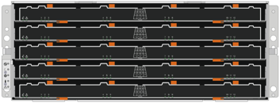
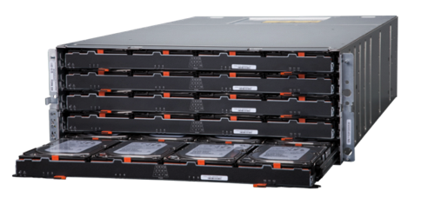
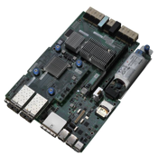
E-Series for Video Surveillance
Disk Shelves
4U/60 x 3.5” drives
Highest throughput
Largest capacity/density
6TB NL-SAS drives
Easy to service
Controller
4GB Cache per system
~ 11.2Gb/s write performance
Cost effective performance
E2700
Up to 180 drives

Slide 8
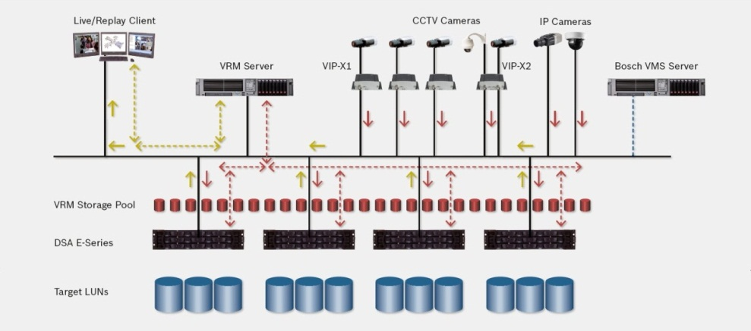
Bosch Video Solution

Slide 9
DSA E-Series - Service Extensions & Service Uplifts
The DSA E-Series portfolio is complete supported from the Bosch support and RMA organization
Service Extensions (available through Bosch Service)
  Standard Service of 3 years may be extended by a additional 4th and 5th year
Advanced Services
  Non-returnable disk option
    for customers that do not want to return failed hard drives, e.g. Governmental, Banks
Opportunity to sell Services and Uplift packages:
  Service Uplifts (available through NetApp Service Partner)
  Standard Next Business Day warranty may be upgraded to
    4 hours Parts Delivery
    4 hours Parts Replacement

Slide 10

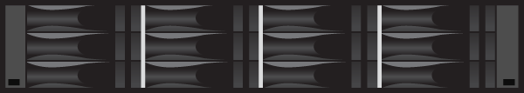
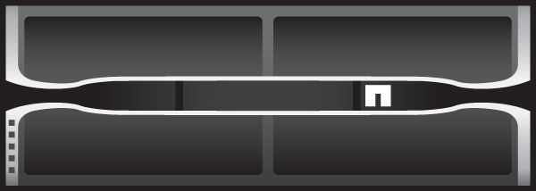
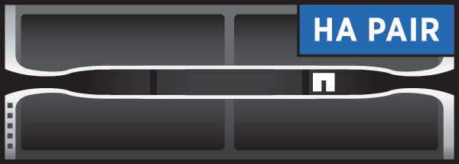
Bosch DSA E-Series Storage System
Fully integrated in to Bosch VMS / VRM
Unique enhancements for Bosch iSCSI cameras provide seamless operations.
Impressive bandwidth performance powers cost-effective solutions
Large installed basis (NetApp close to 1M systems out in the market)
Leading density saves data center floor space and lowers operational costs
Modular flexibility supports configurations customized for customer needs
Bullet-proof reliability and availability designed to ensure continuous high-speed data delivery

Slide 11
Thank You

